Slide 1
Venn Diagram Notes

Slide 2
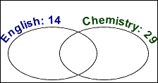
Example 1: Out of forty students, 14 are taking English Composition and 29 are taking Chemistry. If five students are in both classes, how many students are in neither class? How many are in either class? What is the probability that a randomly-chosen student from this group is taking only the Chemistry class?
Step 1: Draw the universe for the forty students with two overlapping circles labeled with the total in each.
2
Step 2: Since five students are taking both classes, put "5" in the overlap.
Step 3: Account for five of the 14 English students, leaving nine students taking English but not Chemistry and put "9" in the "English only" part of the "English" circle.
9
5
24
Step 4. I've also accounted for five of the 29 Chemistry students, leaving 24 students taking Chemistry but not English, so I'll put "24" in the "Chemistry only" part of the "Chemistry" circle.
Step 5. A total of 9 + 5 + 24 = 38 students are in either English or Chemistry (or both). This leaves two students unaccounted for, so they must be the ones taking neither class.

Slide 3
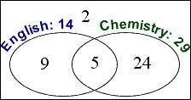
Answer the questions:
If five students are in both classes, how many students are in neither class?
How many are in either class?
What is the probability that a randomly-chosen student from this group is taking only the Chemistry class?
2
24 + 5 + 9 = 38
24/40 = .6
60%

Slide 4
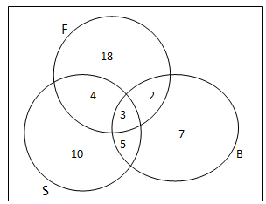
A group of 60 students were asked if they played fieldhockey (F), basketball (B) or soccer (S). The diagram below displays the results.
What percent of the group play:
field hockey & basketball?
field hockey or basketball?
field hockey & soccer?
neither of the three sports?
only 1 sport?
11

Slide 5
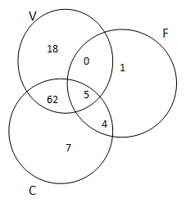
The Venn diagram displays the results of a survey of 100 families regarding technology in their homes. Computer (C), VCR (V) and fax machine (F).
How many families have:
a computer at home?
all three machines?
none of the machines in their home?
no fax machine?
a computer and a VCR?
a VCR or a computer?
62 + 5 + 4 + 7 = 78
5
3
3
(18 + 62 + 7) + 3 = 90
62 + 5 = 67
18 + 0 + 62 + 5 + 7 + 4 = 96

Slide 6
Each member of a sports club plays at least one of soccer, rugby or tennis. The following is known: 43 members play tennis, 11 play tennis & rugby, 7 play tennis & soccer, 6 play soccer & rugby, 84 play rugby or tennis, 68 play soccer or rugby and 4 play all three sports.
a) Display the data in a Venn Diagram
b) How many members does the club have?
Soccer
Rugby
97 Total
68–9–39–7 = 13
2
84-43-2 = 39
4
3
7
29
Tennis

Slide 7
Of the 28 students in a class, 12 have a part time job, 22 have a part time job or do regular volunteer work, and 4 of the students have a part time job and do regular volunteer work.
Display the data in a Venn Diagram.
How many of the students do not have a part time job or do not volunteer regularly?
6
6 students
Job
Volunteer
8
4
10

Slide 8
Homework
This is located on the class website.

