Slide 1
Spanning Trees
Discrete Mathematics

Slide 2
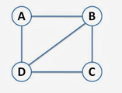
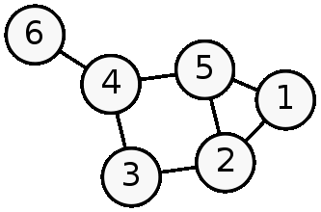
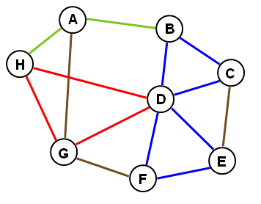
Objectives: Understand cycle and spanning tree.
Cycle – a closed path within a network graph
Graphs with cycles
A graph contains a cycle, if some or all of the traversed edges create a closed path. Important to Note: Not all the vertices need to be used.

Slide 3
Cycles in Network Graphs
This graph has multiple cycles.
Path H-D-G-H (red) is a cycle with no repeated edges that starts and stops at the same vertex.
Path B-D-E-F-D-C-B (blue) is a cycle with a repeated vertex.
Path H-A-B (green) would NOT be a cycle, because it did not close.

Slide 4
More with cycles in graphs
Path A-B-D-A is a cycle, because it creates a closed path with this graph.
Path C-B-D-C is another cycle in this graph.
Path A-B-C-D-A is also a cycle. It would also be a Hamiltonian Circuit, because it passes through every vertex exactly once, and starts and stops at the same vertex.

Slide 5
Cycles in graphs, continued
Path 4-5-2-3-4 is a cycle in this graph, because it creates a closed path.
Path 5-1-2-5 is another cycle in this graph.
Path 3-2-1-5-2-3 would create a cycle, because it would have a closed portion of the path.
Can you find another cycle in this graph?

Slide 6
Spanning Tree – A graph that connects all vertices, WITHOUT creating/containing a cycle.
Spanning trees
These graphs do NOT contain cycles
NOT Spanning trees
These graphs contain cycles

Slide 7
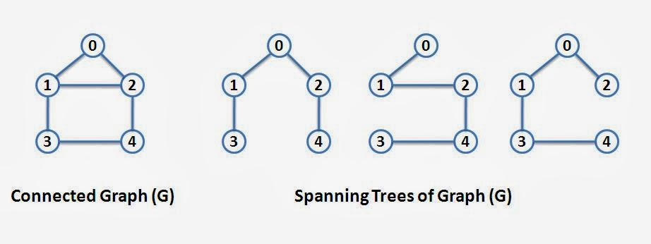
Creating a spanning tree from a connected graph
Three possible spanning trees have been created from Graph (G).
Notice how all of the vertices are connected in each spanning tree, but none of these graphs contain any of the original cycles.

